Slide 1

End-To-End Data Engineering Project using Azure Technology
Nandita Anand Waghchoure
Completed Bachelor of Computer Engineering from Anantrao Pawar College of Engineering and Research, Pune ,2023

Slide 2

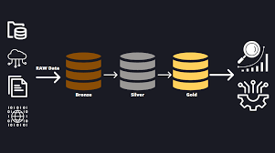
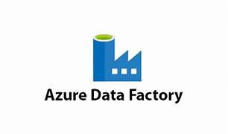
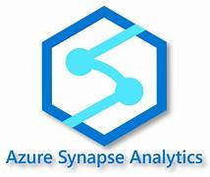



Project overview – Architecture
On-prem SQL server DB

Slide 3
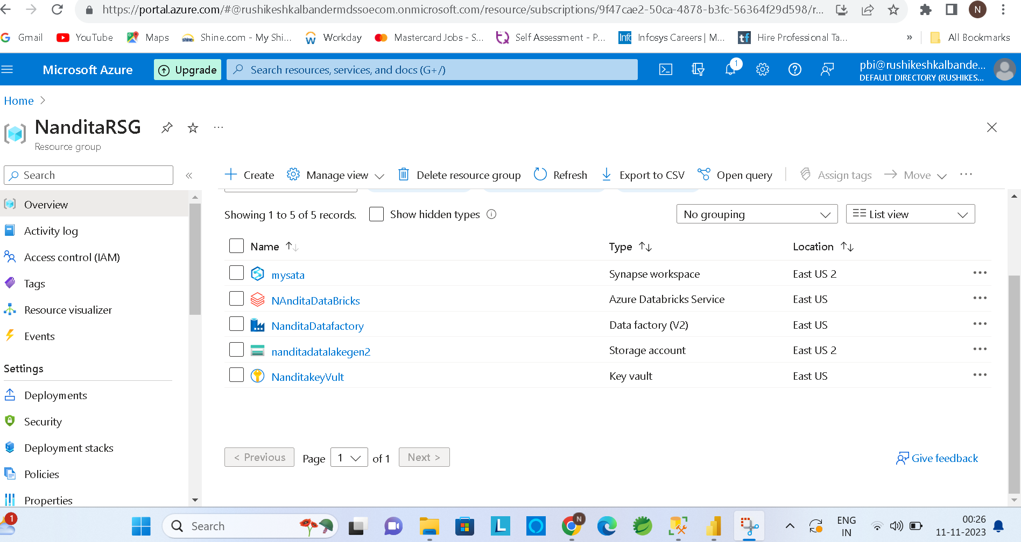
Azure Services I have used in Project

Slide 4
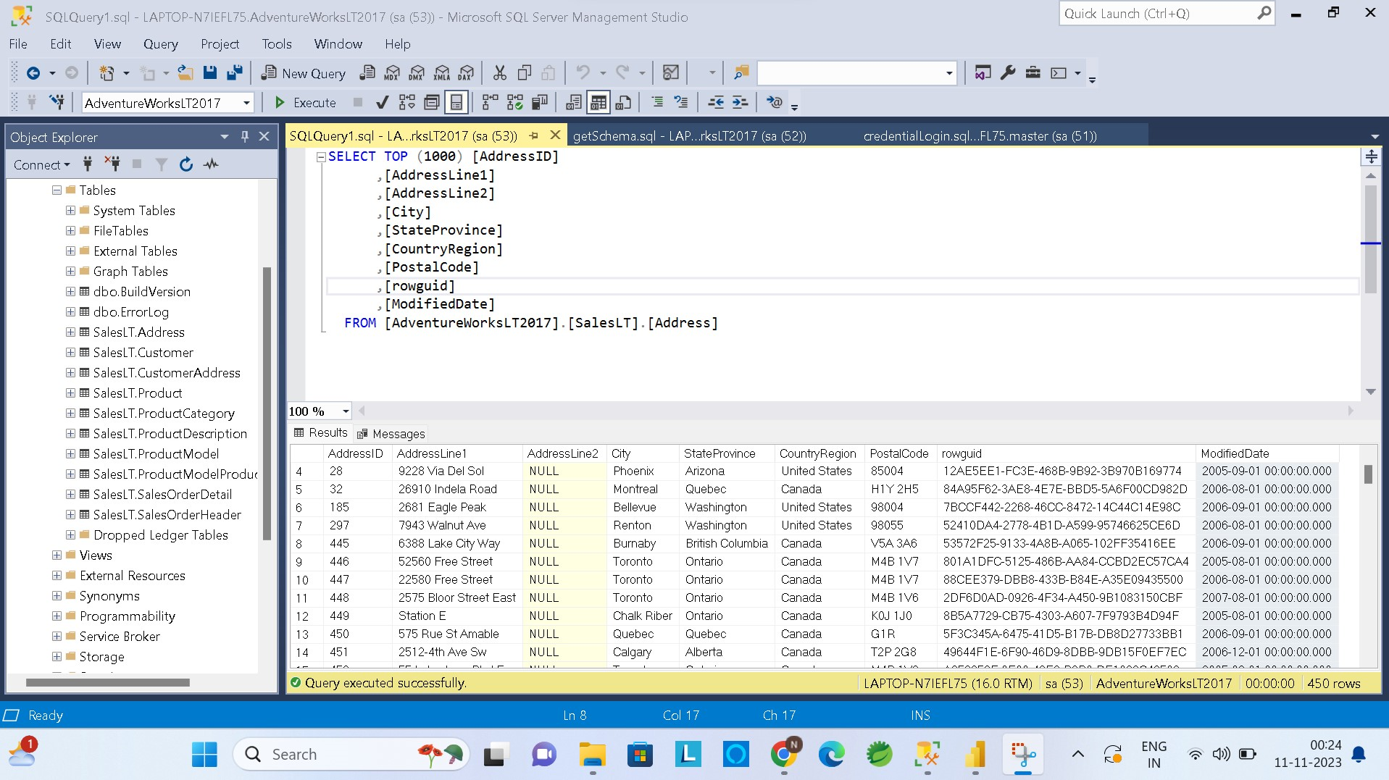
Use cases I have performed on On-prem SQL server DB
Case 1: on prem SQL server dB’s date column is in format of date as well as time, Level 1 transformation will transform that column into only Date format
Case 2: on prem SQL server dB columns which are having its table-name as 2 words e.g. AddressID, Level 2 transformation will convert those table-names , which will separate 2 words with underscore e.g. Address_ID
DB before performing transformation
DB connected to Azure Data Factory

Slide 5
Data House transformation
DB Stored in Storage account
Bronze Layer : Stores the Exact copy of on prem SQL server DB
Silver Layer : Stores the Level 1 transformation copy of on-prem SQL server DB
Gold Layer : Stores the Level 2 transformation copy of on prem SQL server DB

Slide 6
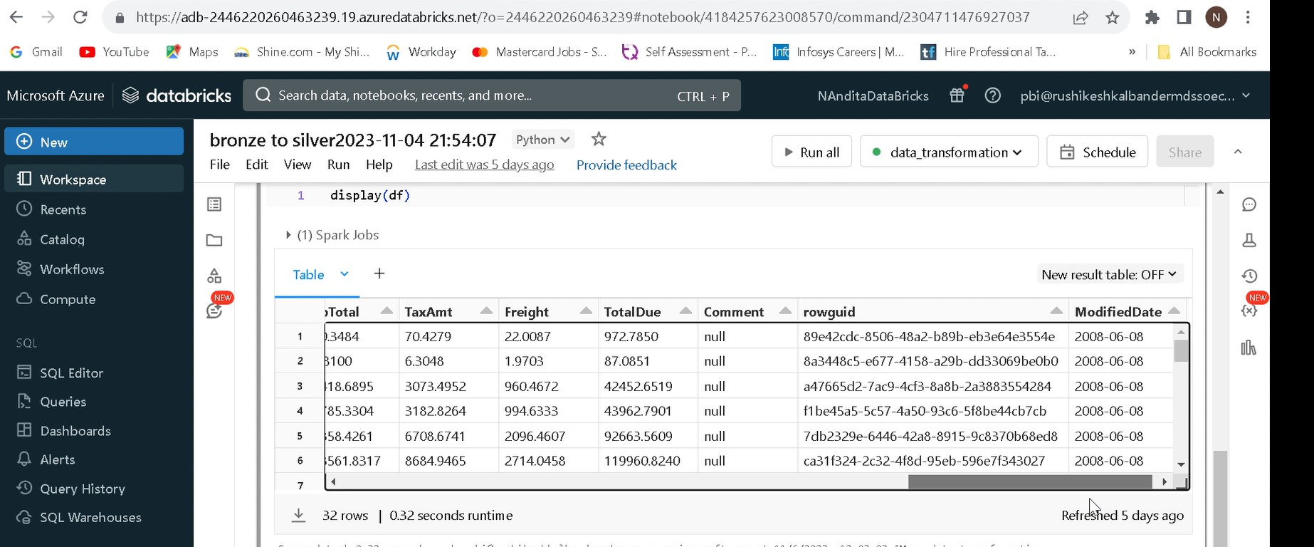
Modified the DB- Level 1 transformation

Slide 7
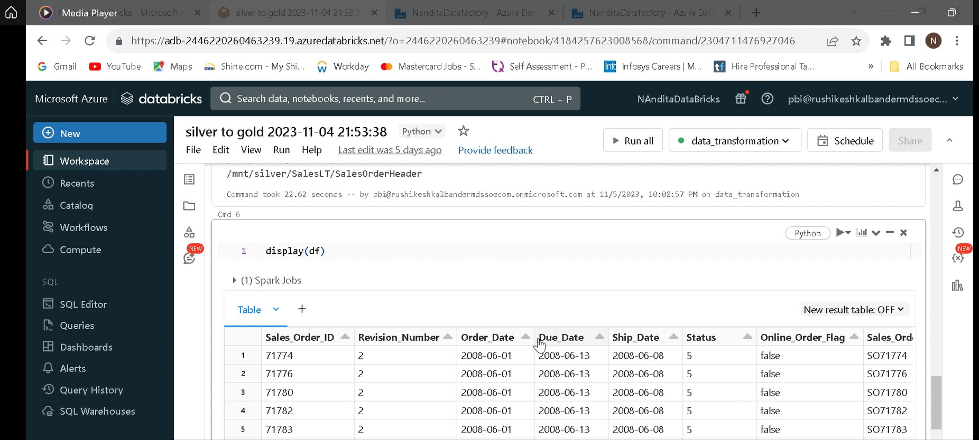
Modified the DB- Level 2 transformation

Slide 8
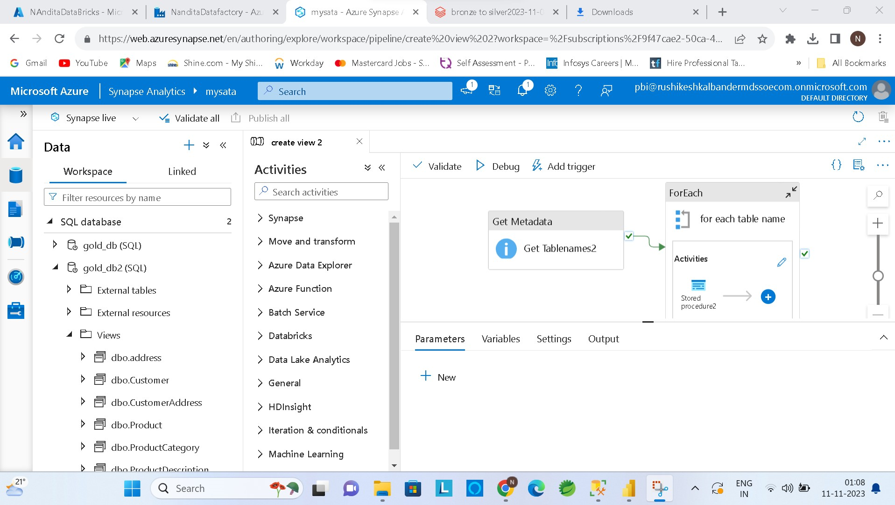
Data Loading of transformed Data into Azure Synapsis Analytics

Slide 9
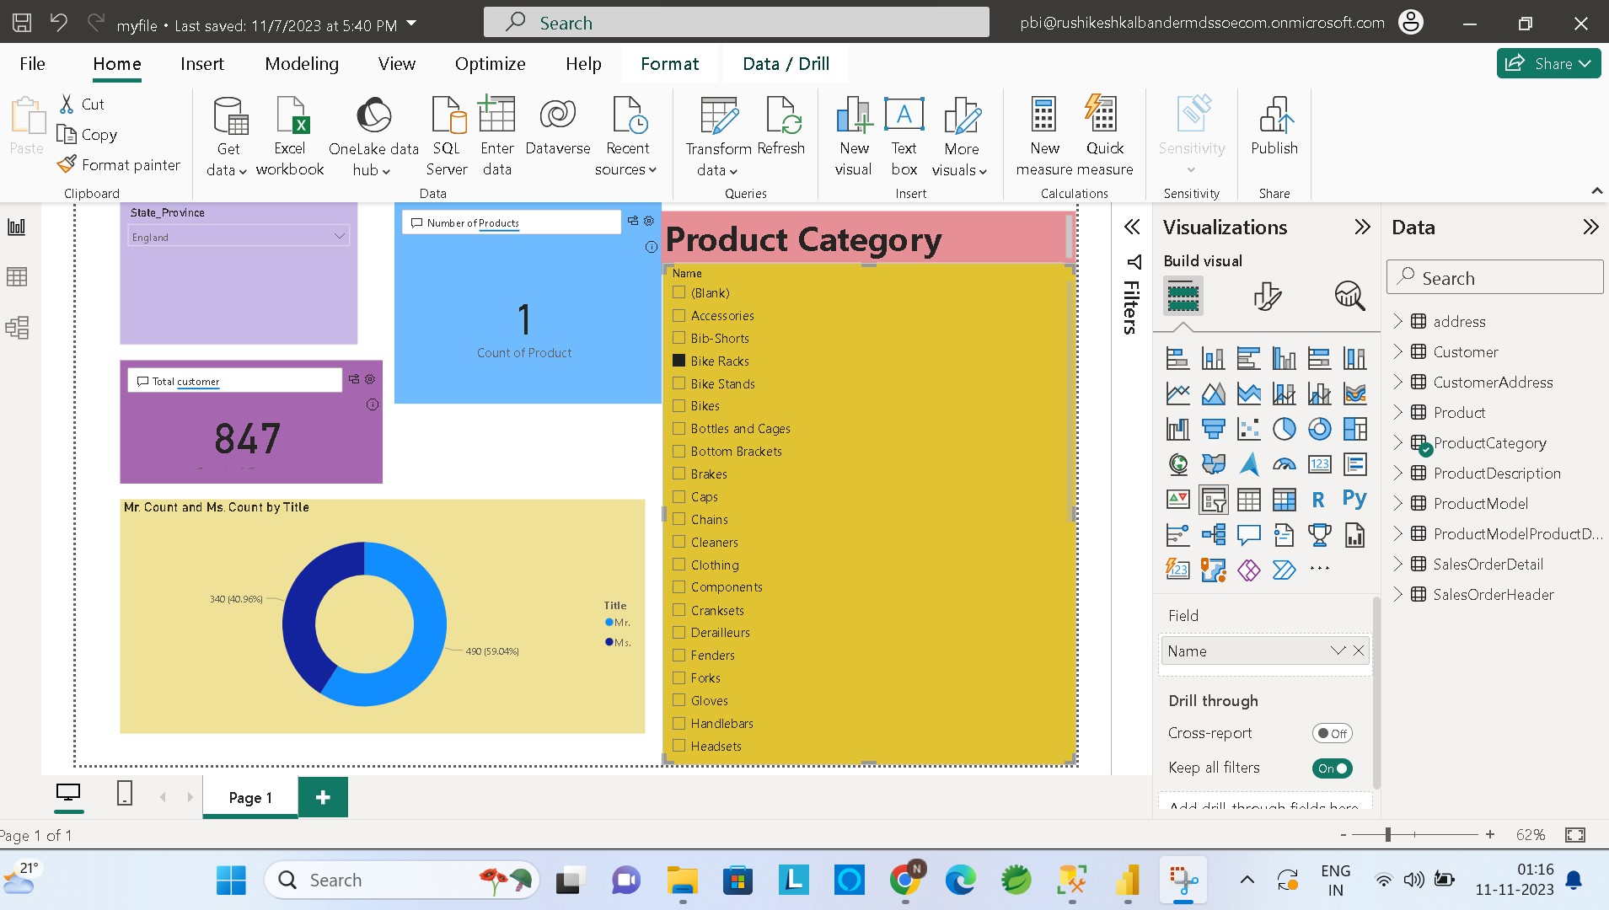
Report of Transformed data

